Slide 1
Engineering Documents (ED) Approval Workflow
RNTBCI EDMS AMO Team

Slide 2
Table Of Contents
1 . Request Process
1-1.Approval Request
1-2.How to set up approvers
1-3. How to set up Distributors
1-4.How to Save Approval Route
1-5.How to search Approval route
2. Approve/Reject
2-1.Approve/Reject
2-2.Reject by Approver
2-3. Cancel Approval Request
2-4. Recall Approval by approver
2-5. Attachment edit/Replace in progress document
3. Approval Workflow History

Slide 3
Request Process

Slide 4
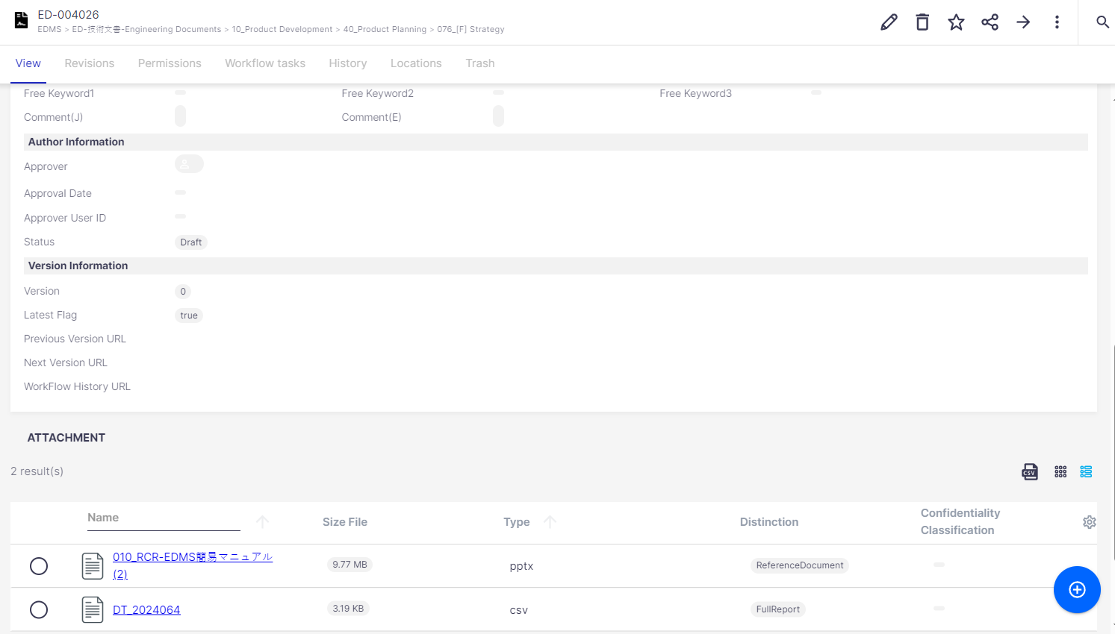
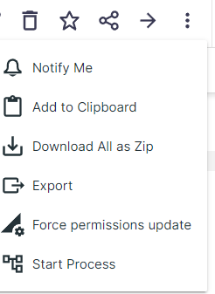
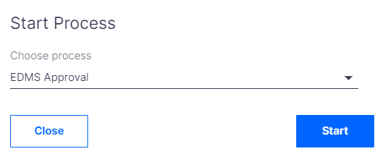
1-1. Approval request
Step 1: To obtain approval, start the approval workflow with the steps below:
Only the author of the document can start the approval process.
The status of the document should be in draft.
② Click on this Icon in the top right of the detailed document screen
①The status is in Draft
③ Click on ‘Start Process’
④
④ Click on Start button to start the approval process

Slide 5
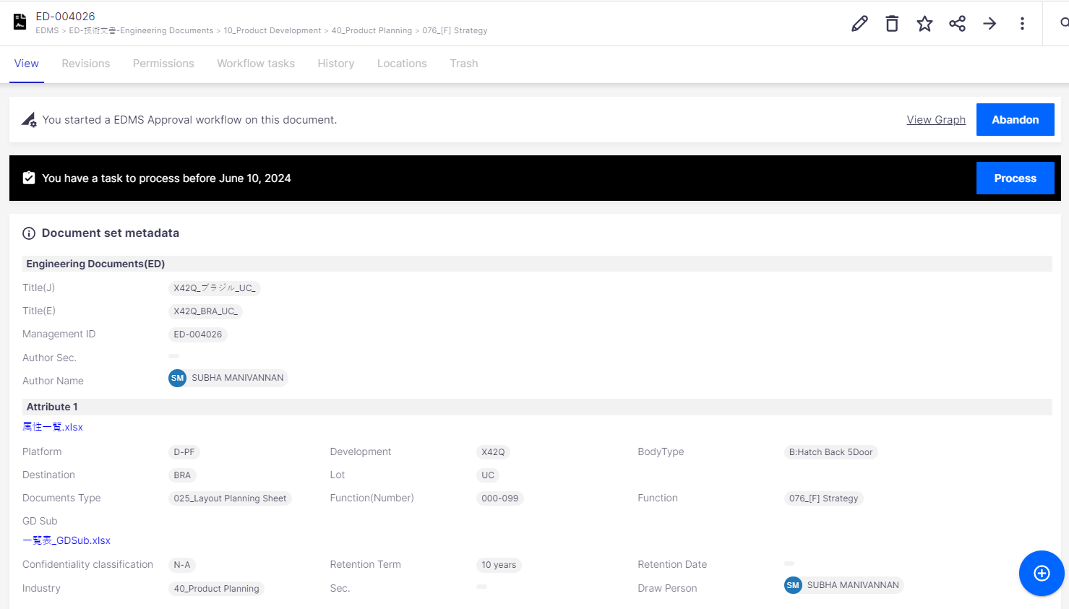
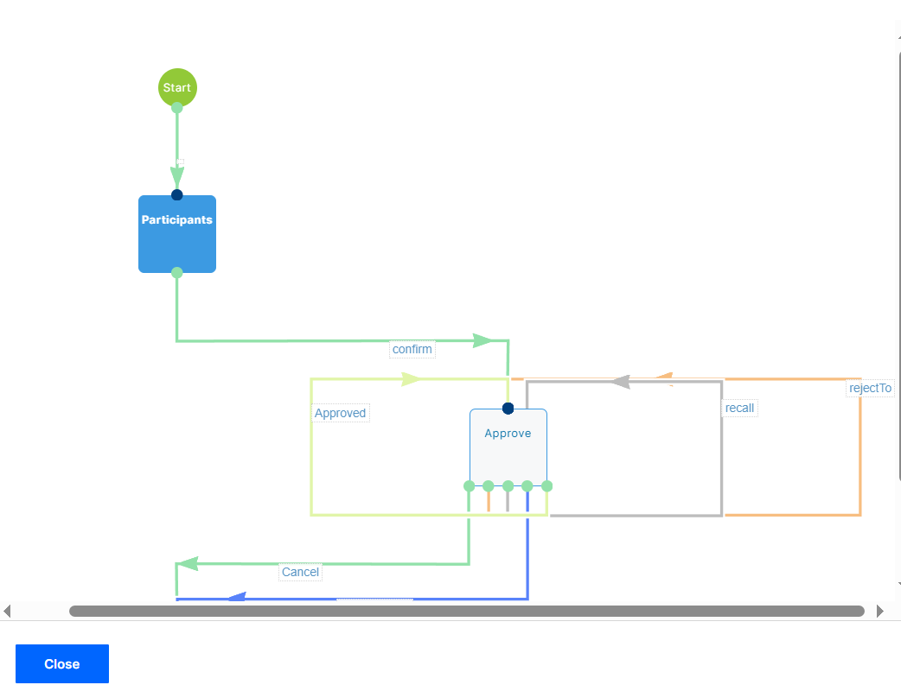
1-1. Approval request
Step 2: The following screen will appear. Click the "Process" button in the black bar to enter the approval workflow screen.
⑦ Click this ‘Abandon’ button if you want to cancel a previously launched workflow.
⑥
⑦
⑤
⑤ Click on Process button
⑥ Click on View Graph button to see the process flow

Slide 6
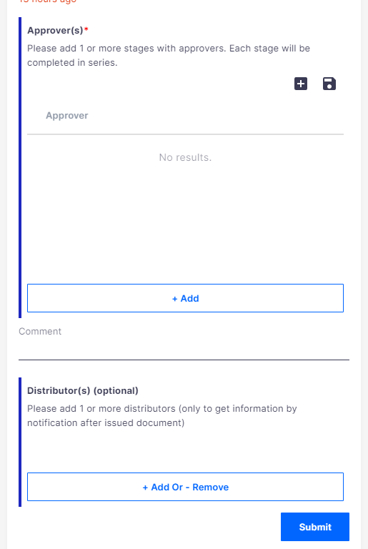
1-1. Approval request
Step 3: On the approval request workflow screen, set the approver (required) and distribution destination (optional), and click the "Submit" button to submit the approval request.
You can save approval routes. Please refer to [How to save approval routes] and [How to search for saved approval route names].
①
① Use the "Add" button to set at least one approver. Please refer to "How to set up approvers."
②
②[Optional] Enter a comment. If entered, the comment will be sent via email to the first approver.
③
③ Provide Distributor details (optional).
All distributors will be notified when this document is approved and published.
If you would like to add distribution destinations, please refer to "How to set distributors."
④
④ Once you have completed all the above settings, click "Submit" to send your request.

Slide 7
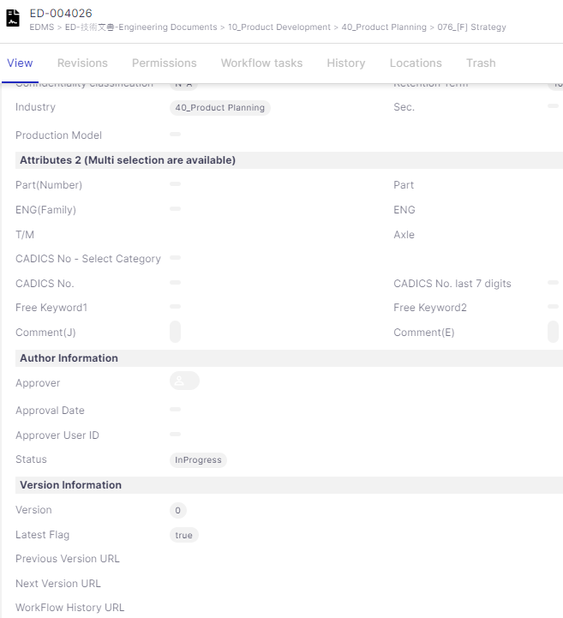
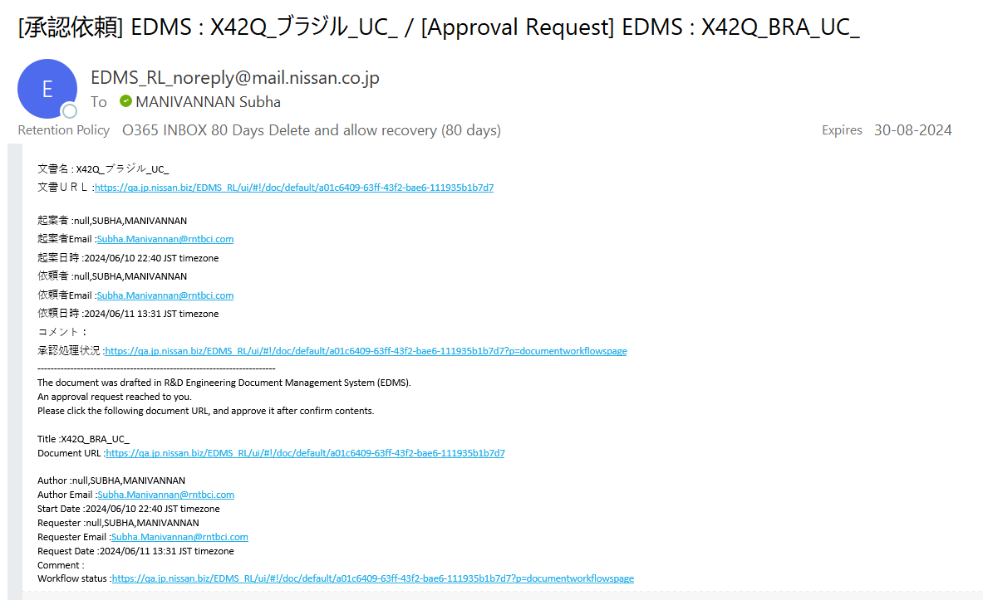
1-1. Approval request
Step 4: After submitting an approval request with the "Submit" button, if you can confirm the following two points, the approval request has been completed successfully.- On the document details screen, the status of the document will change from "Draft" to "Inprogress."- Notification email on the right: [Approval Request] EDMS : xxxx will be sent to the approver's address.

Slide 8
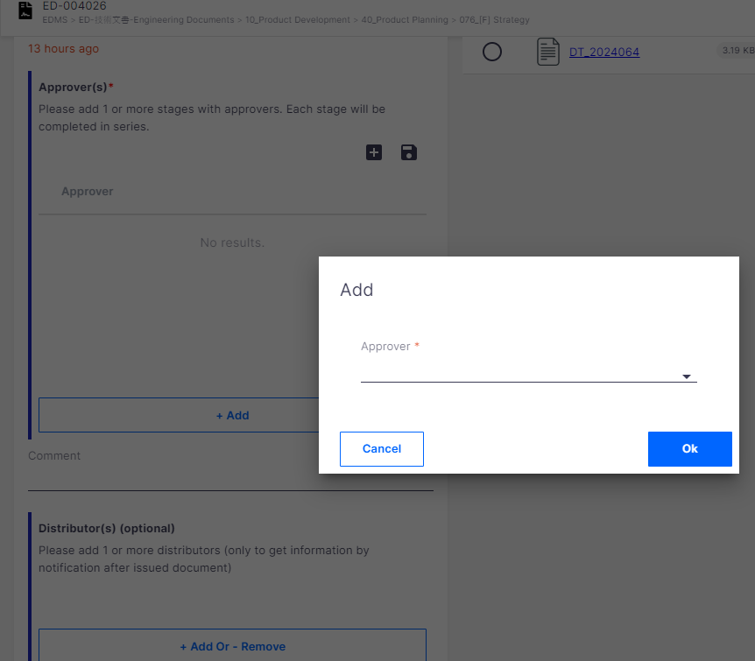
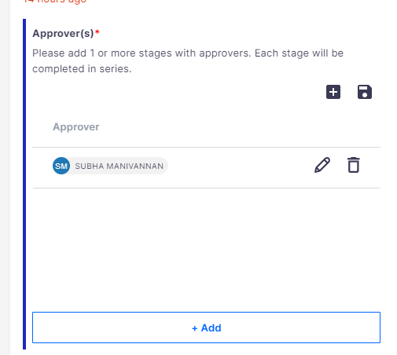
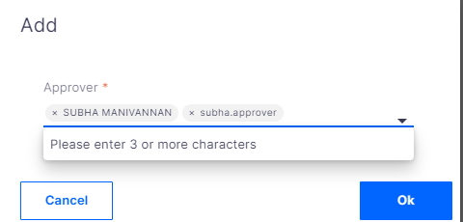
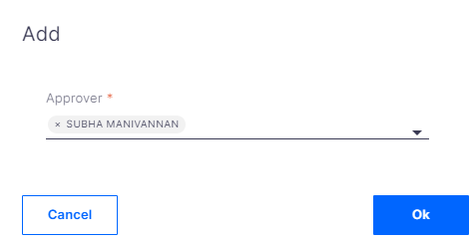
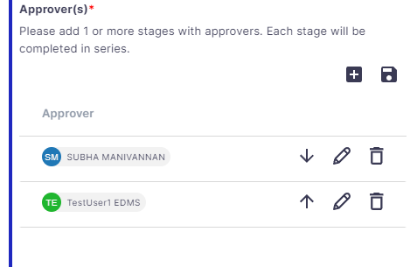
1-2. How to set up approvers:
Please follow the below steps:
We can also add multiple approvers in same stage
② This pop-up box appears
① Click on Add button
④ Target user is selected
①
⑥ Click on Add button again to add next stage of approval
⑤ Click [OK]
③ Enter from 3 characters of username or user ID and select target user from list
If you want to modify/delete/change approver stage, please use these buttons

Slide 9
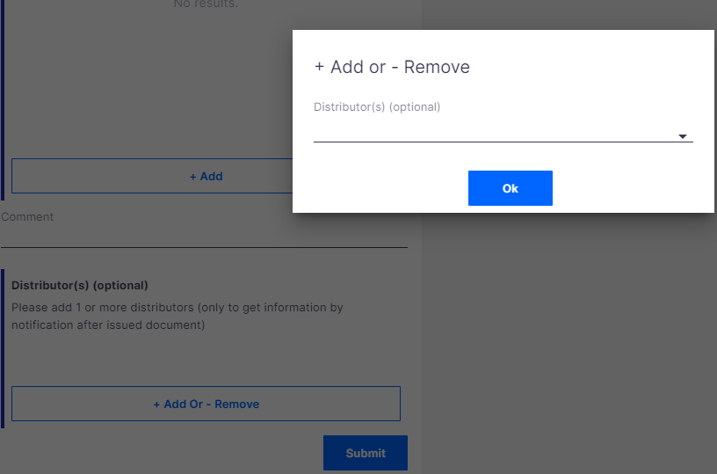
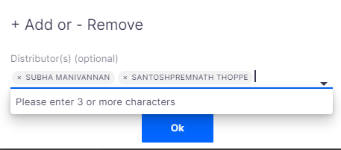
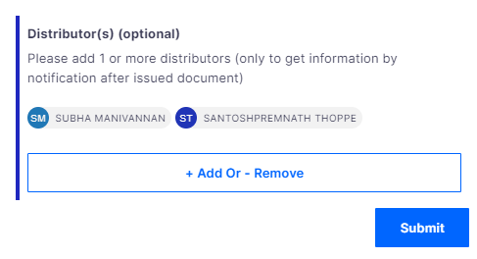
1-3. How to set Distributors
You can set Distributors as needed by following steps. When document is approved, notification mail will be sent to Distributors.
② This pop-up box appears
③ Select UserIDs
④ Click OK
① Click on +Add or –Remove button
If you want to delete any user from Distributor list, click[Add Or Remove] button again and in [Add or Remove] window, you can remove user you want.
⑤Click on Submit button

Slide 10
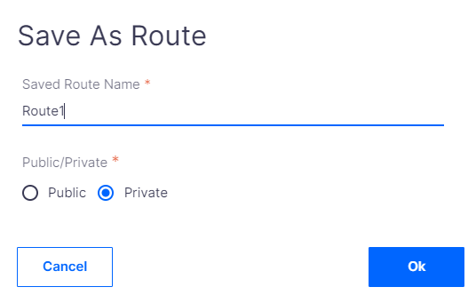
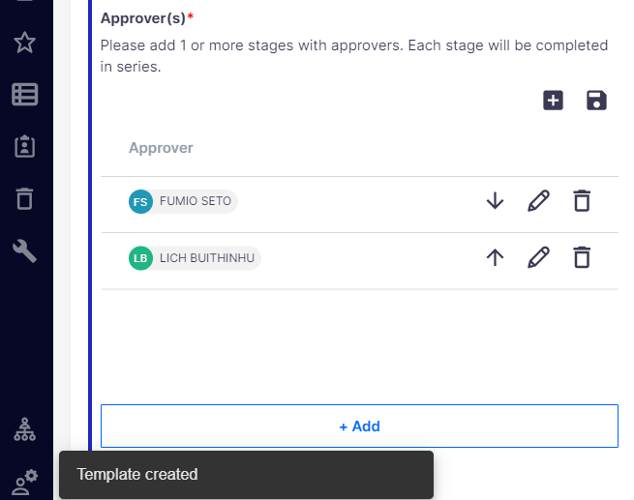
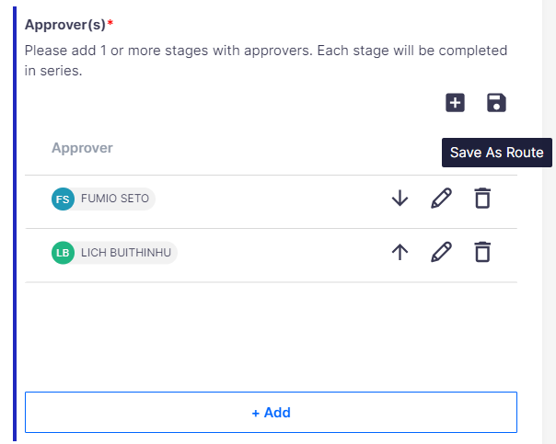
1-4. How to save approval route
② Select [Save As Route] icon
③
③ Input name in [Saved Route Name]
②
④
④ Select [Public] or [Private]
⑥ [Temple created] message appears. Approval Route is saved as template.
①
① Set approver
⑤
⑥
⑤ Click [OK]
※If Save as Public: All ED Author can view and use this saved route.
※If Save as Private: Only ED Author who saves route can view and use this saved route.
Note: Private templates can be used only by the creator of the template. Whereas, Public template is visible and can be used by the Job IDs added in the template.

Slide 11
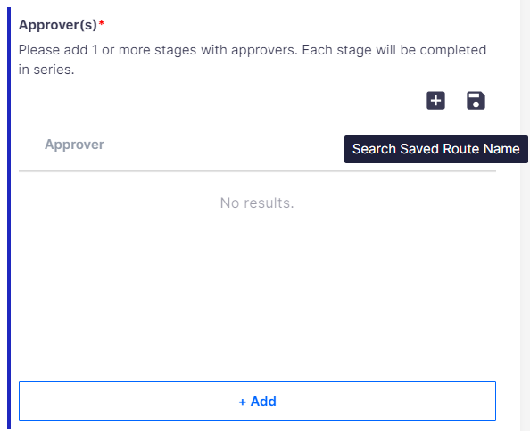
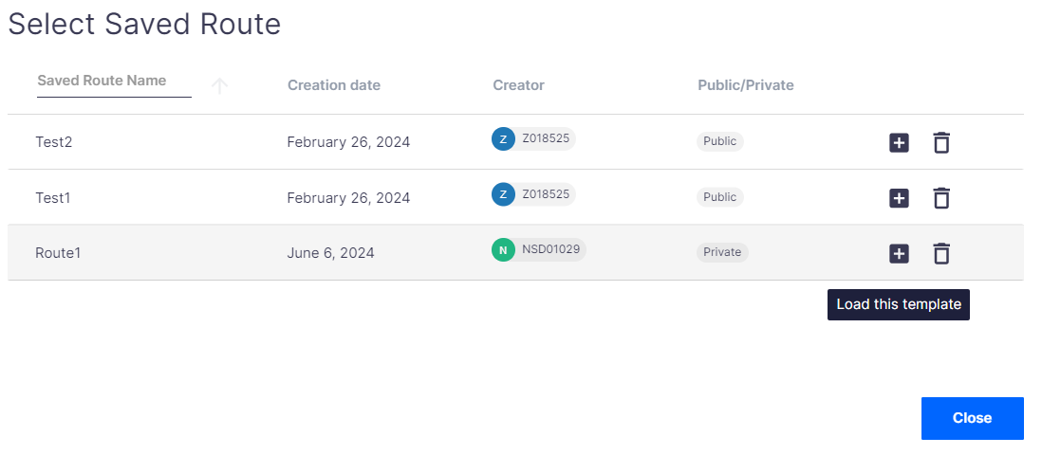
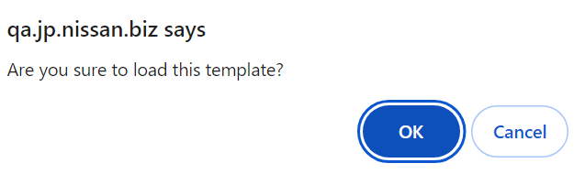
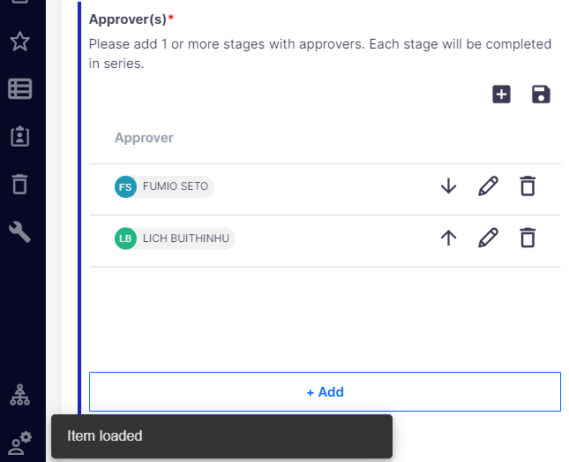
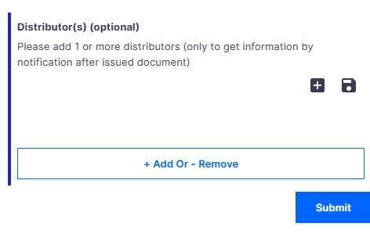
1-5.How to search Saved Route Name
①
③
③ Pop-up message appears. Click [OK]
① Click [Search Saved Route Name] icon
②
② [Select Saved Route] window appears. Find your target Route Name in the list and click [Load this template] icon
Please note that the saved route works as same for distributor. (as explained above)
④[Item loaded] message shown in bottom left corner. Target Route is loaded.
④

Slide 12
Approve/Reject

Slide 13
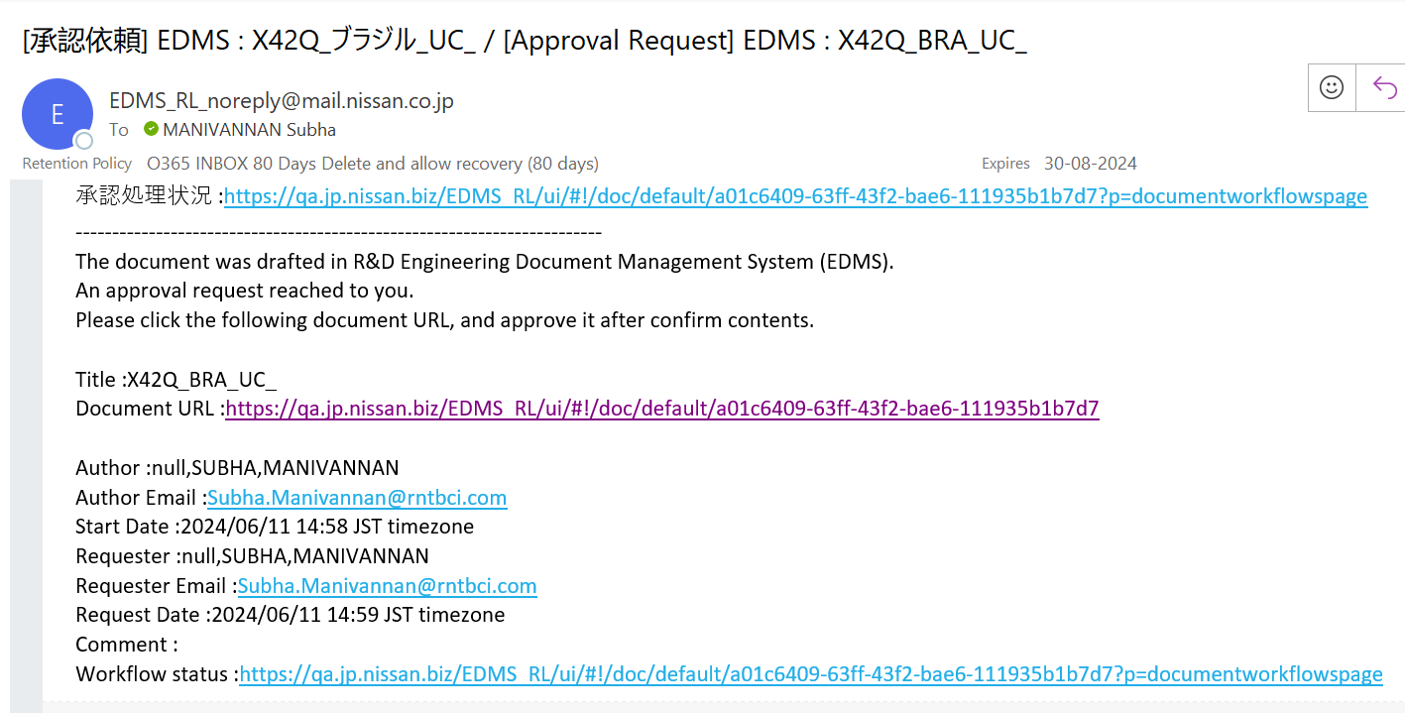
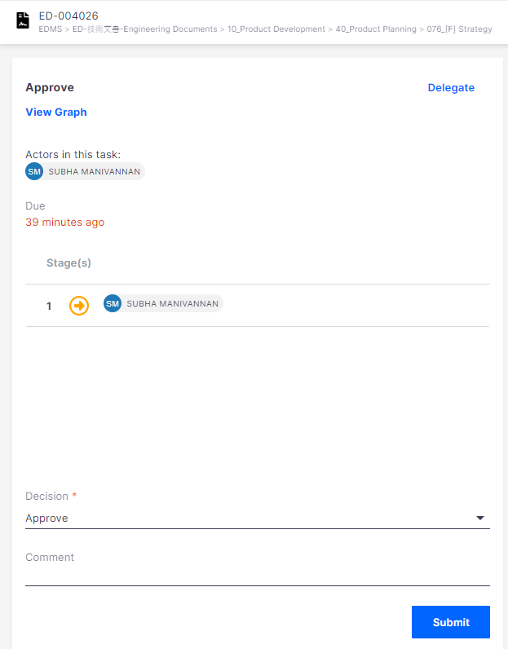
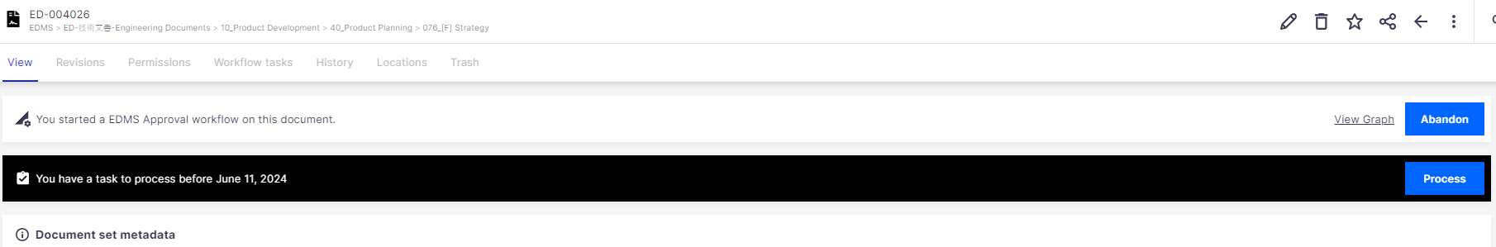
2-1. Approve/Reject
Step 1: After author submitted approval request, notification of approval request will be sent to 1st approver.
Approver can access Approval screen by two methods.
Method 1: There is URL to access target document in notification mail. Approver can click this URL to access approval screen as below.
Approval screen displays.
① Click on Process button
①

Slide 14

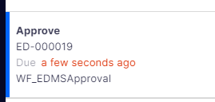
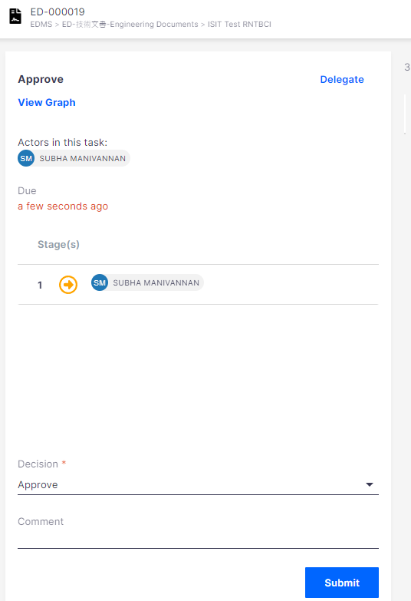
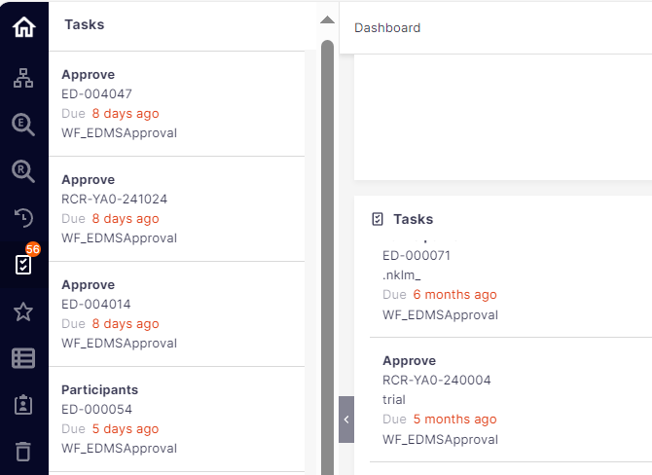
2-1. Approve/Reject
Method 2: Access approval screen via Task menu in left side navigation bar or Task block on Top page as below.
① Click Tasks icon from left side navigation bar.
② Select target task.
③Approver screen displays.
Or, you can select target task from Task block in Toppage to access Approval screen

Slide 15

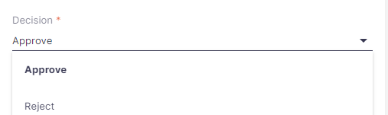
2-1. Approve/Reject
Step 2: In Approval screen, from Decision dropdown menu, select [Approve] or [Reject], then click [Submit] button.
①If you want to confirm attribute, please click Document ID here.
①
②
③
① Select Approve/Reject from the list.
② [Optional] Provide your comments here.
③ Click on Submit

Slide 16
2-1. Approve/Reject
The Current approver can also delegate the approver as below.
Delegating means that they can do the task at your place, but you still remain responsible for the task. You don't lose your rights on the document.
Delegate option is only displayed to the current in progress approver, hence current approver can delegate the task to another approver using this option.
But, incase if the approver is not available to approve due to job transfer or retirement, kindly reach EDMS support helpdesk keeping creator in CC, we will delegate the current approver by new approver.
Once Workflow is started, the approval stages cannot be skipped or else the Workflow error will occur.
The same approver can be kept as a delegated approver at multiple stages.

Slide 17
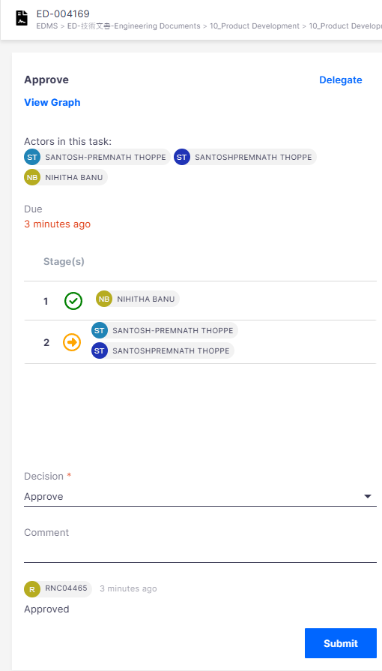
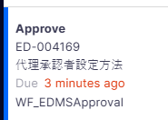

2-1. Approve/Reject
Steps to delegate Approver:
Step 1. Open the task menu and select the Document set that Current approver need to provide delegate access

Slide 18
Step 2. On approval screen, delegate option will be display on top right corner, click on it.
Click on delegate

Slide 19
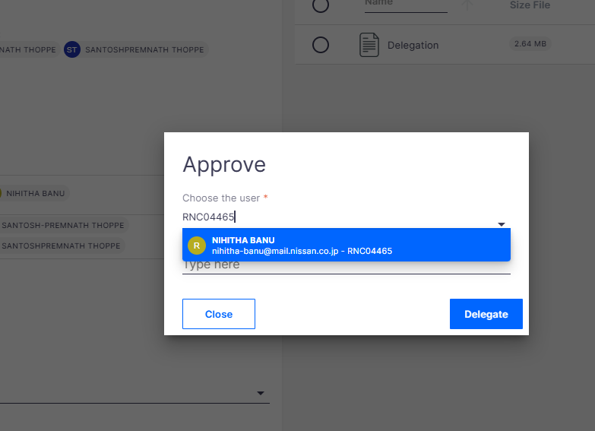
Step 3. Enter user ID (New Approver ID) and click Delegate.
Enter the new approver ID whom the approves access has to be delegated
Enter the comments but not mandatory
Click Delegate

Slide 20
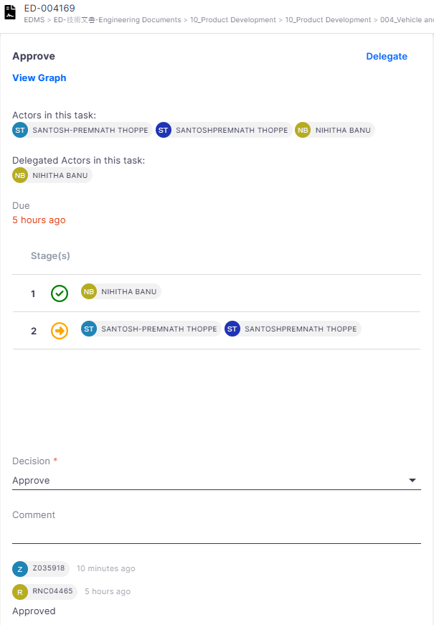
Step 4. Delegated Approver details will be displayed under “Delegated Actors in the task” section.
Delegated Approver details will be displayed under “Delegated Actors in the task” section.

Slide 21
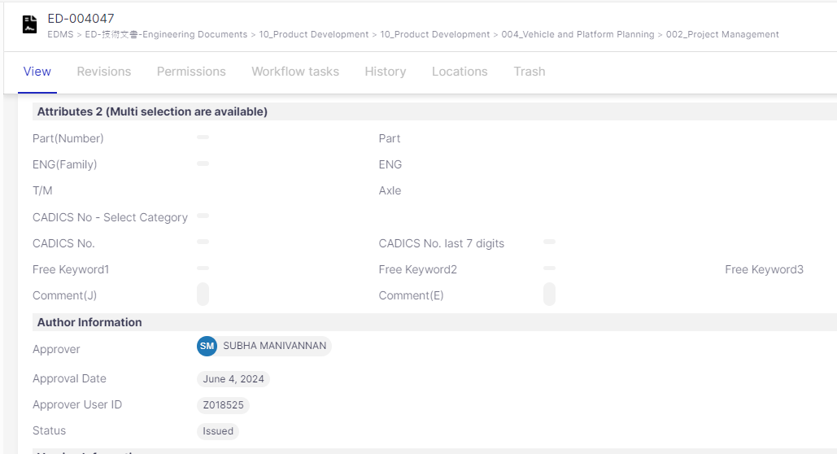
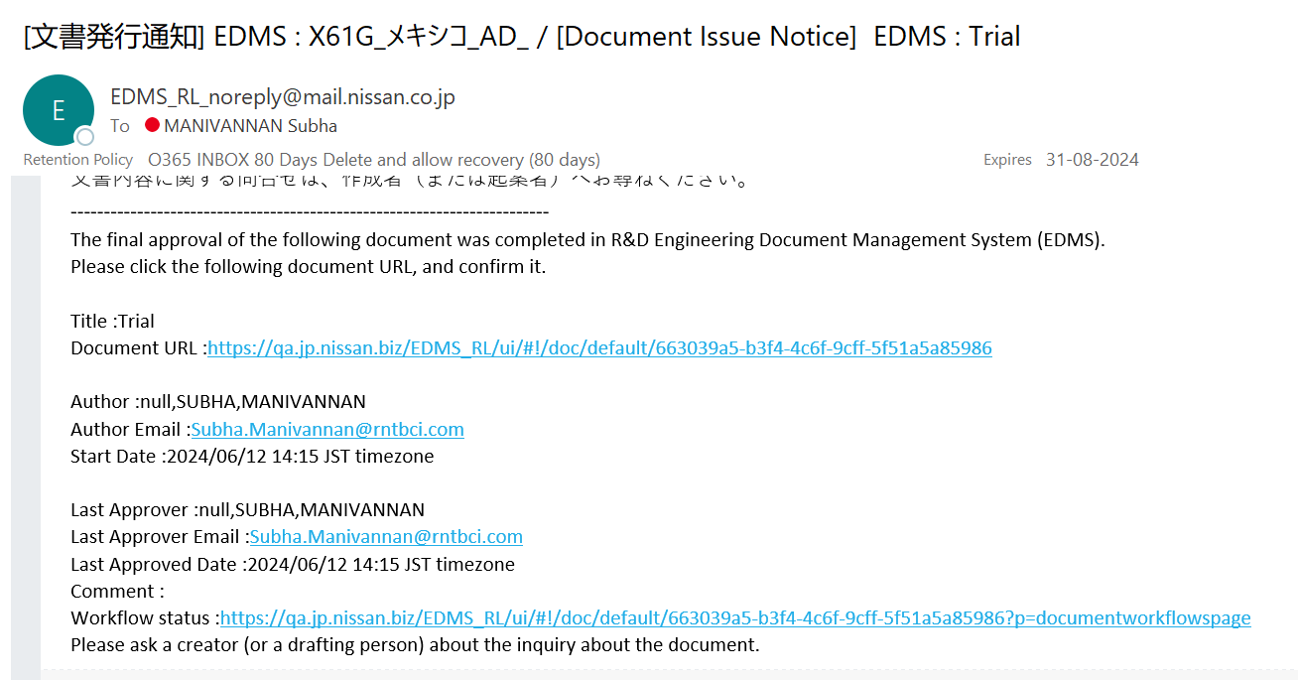
2-1. Approve/Reject
Step 3: After document is approved, document status is changed to [Issued].
After approved, you cannot change document attributes or attachment file.
Below notification mail will be sent once document is issued.

Slide 22
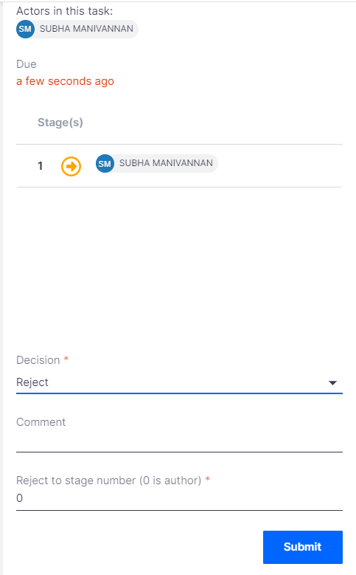
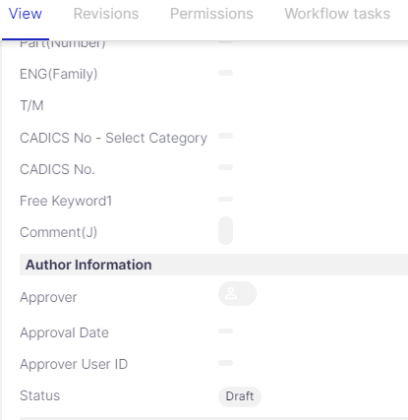
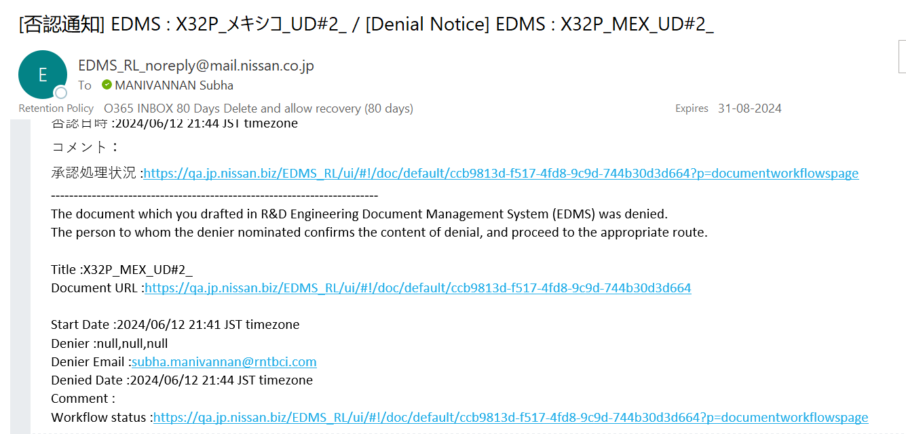
2-2. Reject by Approver
When approver rejected, status of document change back to [Draft] . Notification mail of Rejected is sent to author and document cannot be issued. Author need to recheck document to modify as needed and submit approval request again.

Slide 23
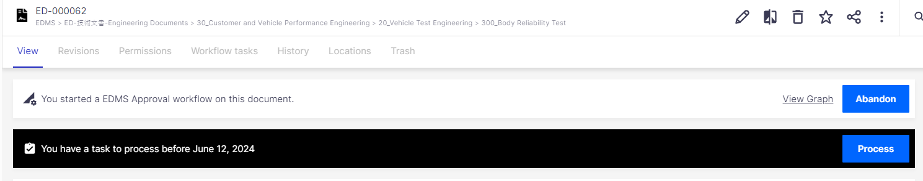
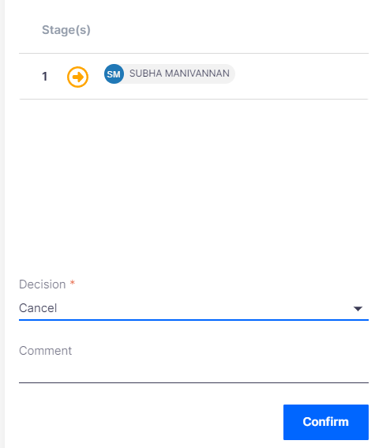
2-3. Cancel Approval Request
You can cancel workflow by clicking this “Abandon” button but please note that in this case, no notification mail will be sent approver.
In Approval workflow screen, select [Cancel] from Decision dropdown menu and click [Submit] button
①
① Select Cancel from the dropdown menu.
②
② [Optional] Provide your comment here.
③
③ Click on Confirm

Slide 24
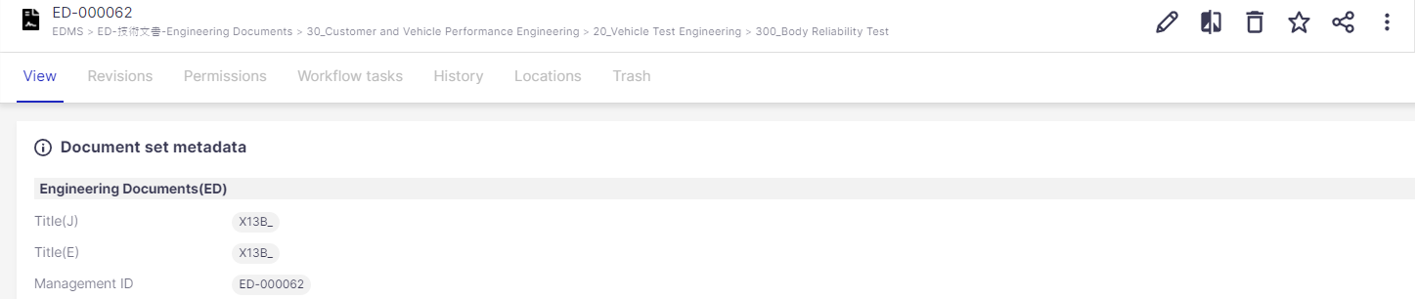
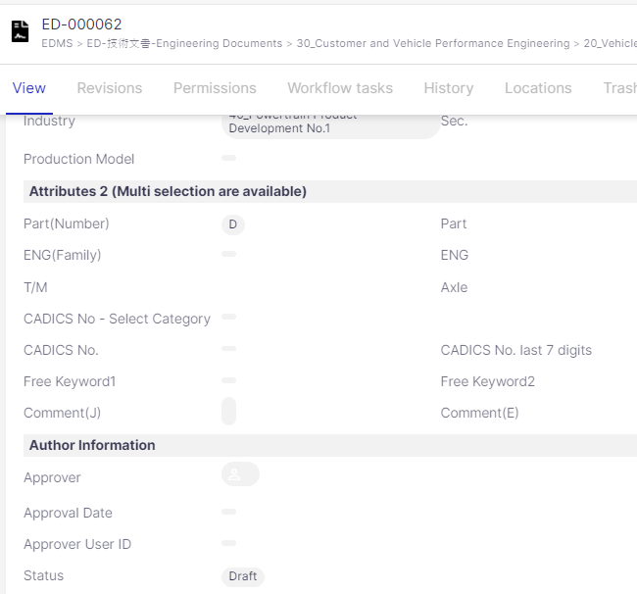
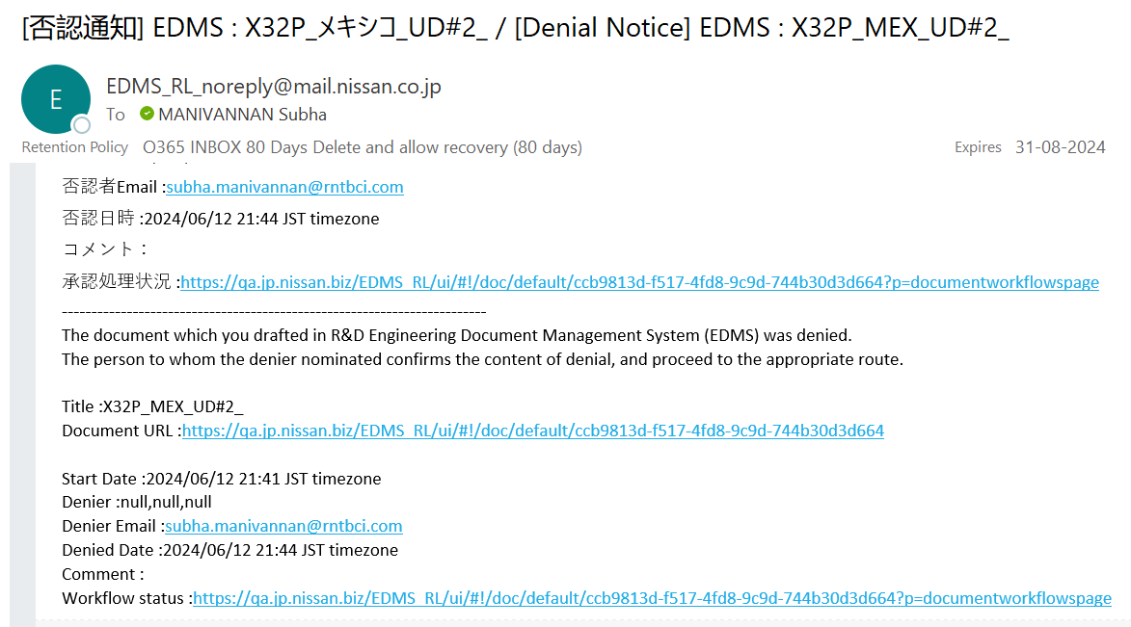
2-3. Cancel Approval Request
Step 3: After clicking [Submit] button, you can confirm below 3 points to make sure cancellation of approval request has been completed.
①Confirm that black bar of workflow on detail screen disappears.
③ Confirm that “Approval Request Cancel” notification mail is sent to approver
②Confirm that status of document change back to Draft.

Slide 25
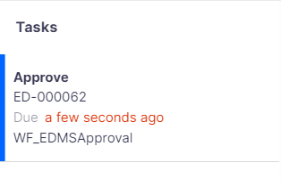
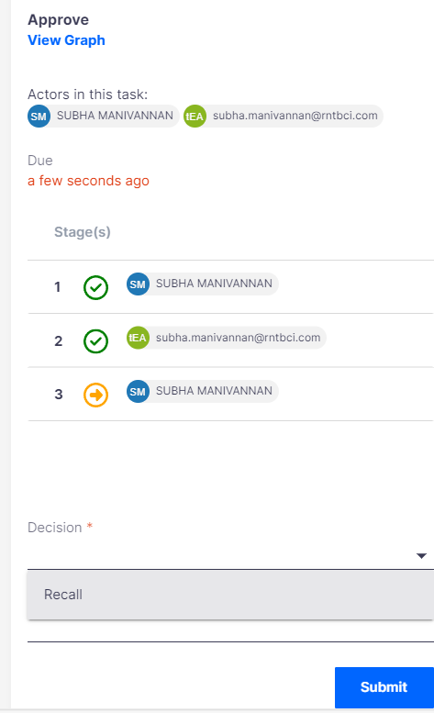
2-4. Recall Approval by Approver
Step 1: If middle approver (=not final approver) want to recall their approval decision, please follow below steps to access workflow to recall
① Click Tasks icon from left side navigation bar
② Select target Tasks
③ Select [Recall] from Decision dropdown menu
④ Click [Submit] button

Slide 26
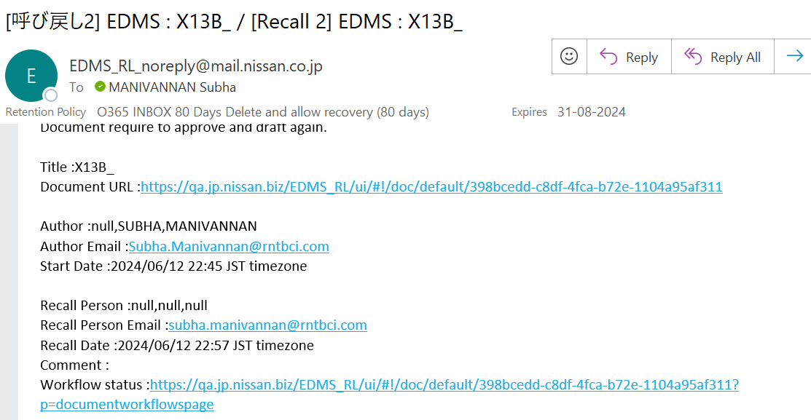
2-4. Recall Approval by Approver
Step 2: After clicking [Submit] button, Recall notification mail will be sent to author. Recall action is completed.
Approver can confirm document content again and continue to re-do Approve/Reject in Approval screen.
Sample of Recall notification mail sent to author

Slide 27
2-5. Attachment edit/Replace in progress document
※ If the Author wants to edit or replace the document while the status is inProgress
※ The Author has to abandon the workflow to proceed with the changes (edit/replace)
and then restart the workflow.
※ By default , Current approver can edit/replace the workflow.

Slide 28
Approval Workflow History

Slide 29
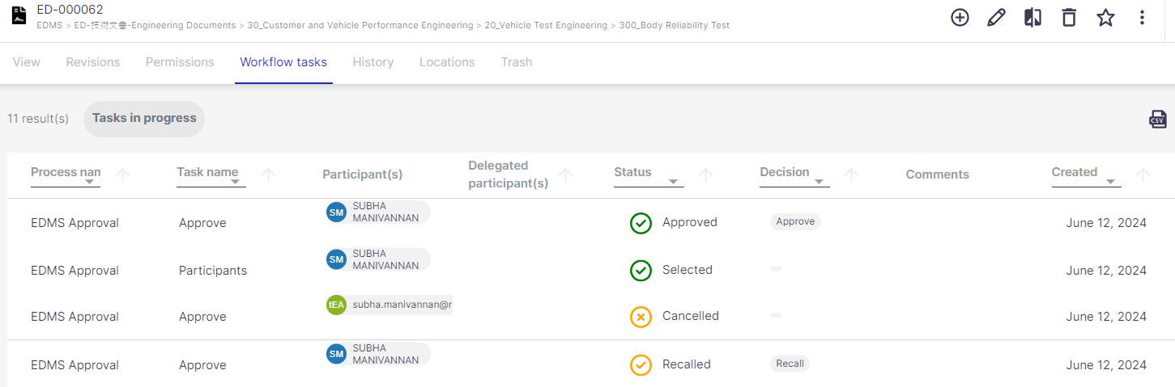
3. Approval Workflow History
If you want to confirm Approval workflow history, please select [Workflow tasks] tab in detail screen of document as below. All workflow actions such as Approval request, Approve/Reject, Cancel, Recall, etc) are listed here.
①Process name:
Show title of workflow
②Task name：
Task to be done during approval workflow
③Participants：
List requester/approvers of all stages in approval workflow
④Delegated participants：
Delegated person will be listed here. As default, it is empty.
⑤Status：
Display approval status
⑥Decision：
Display approver’s action: Approve/Reject
⑦Comment：
Display comment requester/approver input during workflow
⑧Created：
Date to perform task such as approval request/ approve/ reject…
①
②
③
④
⑤
⑥
⑦
⑧

Slide 30
Thank you

